Slide 1
Teacher’s Notes :Possible Lesson Plan Ideas
Note these are just some ideas. Feel free to omit or change the order as suited to your students’ needs and your learning objectives, time constraints, teaching style etc. I will pick and choose which activities to do, rarely trying to do all of them.
1) Warm Up/ Topic Introduction: If wanted a related warm-up activity could be used to introduce the topic/vocabulary. E.g. show related pictures, give scrambled words, have matching words to pictures activities, general related questions, etc.
2) Picture Speculation: show just the picture and title. Ask students to create a story or describe the picture in chat (or raise hand to do so using the microphone). I usually pick two students to do this first, then open it up to volunteers. The two selected can be marked if you want.
3) Listening Comprehension: Ask the students some general (or specific) questions for them to listen for the answers to. You could write the questions on the board or even have students generate their own questions (which may or may not be answered in the text). Several options. For a strong class, review answers after the teacher reads the script. For weaker classes, review the answers after the listen and repeat.
4) Teacher Reading: Without showing the text, the teacher reads the drama to the class (or plays a recorded version).
5) Listen and Repeat: I read the text, pausing after each sentence. Instruct the students to listen and repeat each sentence (at home with microphone off) to help develop listening and pronunciation skills
6) Show the students the text: Give the students a copy of the text or project it to the front screen. Allow students to read silently, and ask questions if they want (e.g. word meanings or pronunciation). Allow peer answers before the teacher answers any questions.
7) Vocabulary Check: Ask the students if there are any difficult/new words. Even if none are mentioned, I usually highlight the hardest words and ask for the meaning (spot check of vocabulary understanding). Have students make sentences with these words. Bring in other related vocabulary (or even grammar points) if appropriate and as time allows.
8) Group/Pair Roleplay: Put students into groups, one for each of the characters. They then go through the mini-roleplay reading their assigned role. Encourage dramatic reading with voices, emotions etc. This could be marked or unmarked (with the teacher just circulating)
9) Roleplay In front of Class: Put students into groups, one for each of the characters. (you could ask for volunteers, instead). They then go through the mini-roleplay reading their assigned role reading in front of the class. Microphones can help for quiet classes. Encourage dramatic reading with voices, emotions etc. This could be marked or just for fun.
10) Group Roleplay: Put students into groups, one for each of the characters. (you could ask for volunteers, instead). They then go through the mini-roleplay reading their assigned role. Encourage dramatic reading with voices, emotions etc. This could be marked. A follow-up role-play in front of the whole class could also be done.
11) Discussion Questions: Two related discussion questions have been provided for each mini role-play. These could be done in pairs, in front of the class, or even as a written assignment (students could do both or choose their favourite one)
Typically in a class I mention that I will be awarding participation marks for volunteered comments (e.g. excellent picture speculation, questions, answers etc. (just for people who were not called or assigned to do a task). Try to reward those who make a sincere effort or take risks, not just the best students.

Slide 2
12 Christmas Mini-Dramas

Slide 3
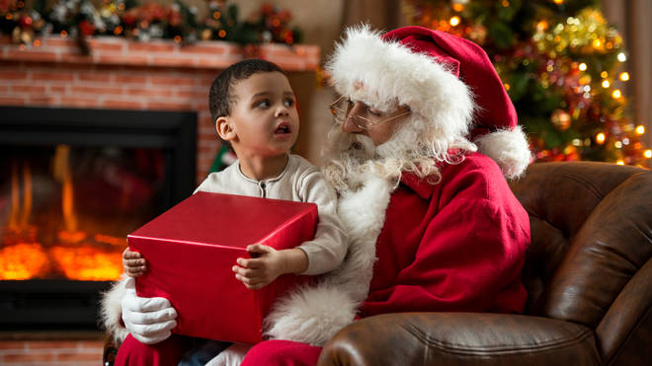
1
Talking to Santa
Picture Speculation
Describe the picture
Tell a story
Imagine what is happening
Be creative!
Santa: Ho Ho Ho- Merry Christmas! What is your name little boy? Have you been good this year?
Tommy: Hello, Santa. My name is Tommy and I have been VERY good this year. I always do my homework and keep my room neat.
Santa: That is fantastic! What would you like for Christmas this year?
Tommy: I’ve already sent you a letter with my list. Didn’t you get it? Hey, are you the real Santa?
Santa: Yes, of course. I am just old and sometimes forget things.

Slide 4
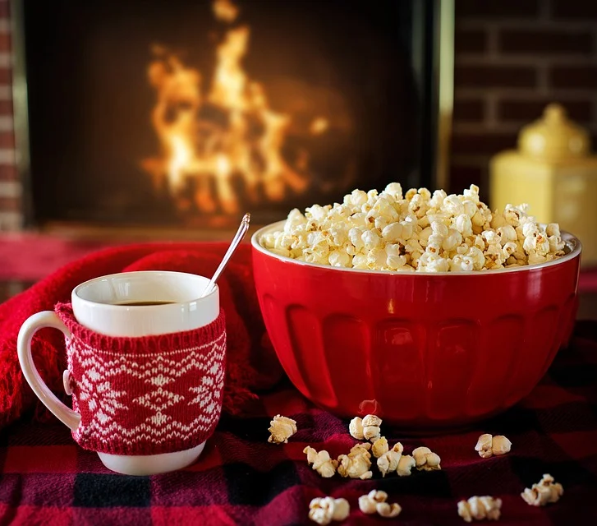
2
A Warm Holiday Snack
Ms Lee: What a cold and windy winter night! Thanks for coming over for a chat.
Ms Chan: Well, thanks for inviting me. I like to get out and visit my friends during the holidays. I really like your house decorations!
Ms Lee: Thank you. I’ve made some fresh popcorn and hot chocolate for us to enjoy.
Ms Chan: How nice. The popcorn smells great and I think the hot chocolate will warm me up.

Slide 5
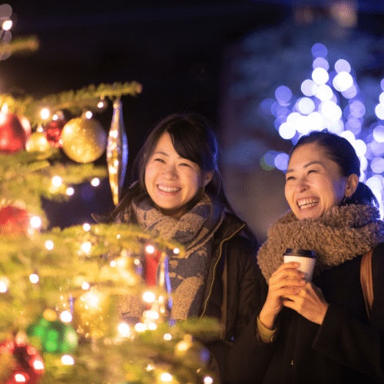
3
A Time for Giving
Catherine: What beautiful decorations in the park. I’m glad we came out to see the Christmas sights! Some people are even singing traditional Christmas carols!
Annie: Yes, I love the energy and excitement of the holidays. Look at this tree! Where did they find such a big tree in Hong Kong?
Catherine: It is rather beautiful. Can you see under the tree there are some donation boxes to give food to the needy.
Annie: What a wonderful idea! Let’s go shopping right now so we can help. After all, Christmas is a time for giving.

Slide 6
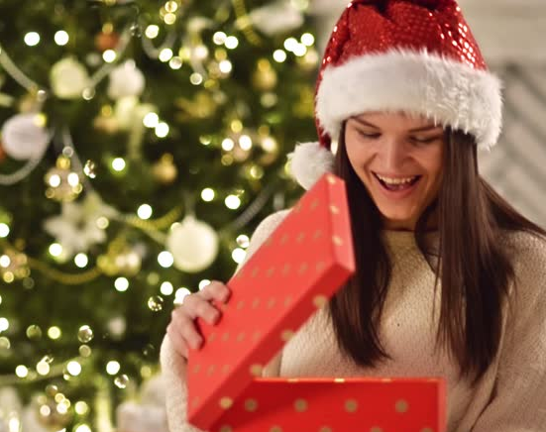
4
The Christmas Present
Susan: What a nice Christmas present. I love the red paper on the box. I wonder what’s inside.
Mother: I’m glad you like it. I was up all last night wrapping presents. Go on- open it.
Susan: Wow! A book about wild animals. You know how much I love animals. Thank you so much!
Mother: You are very welcome, my dear daughter. You have been such a good girl this year so I wanted to find something special.

Slide 7
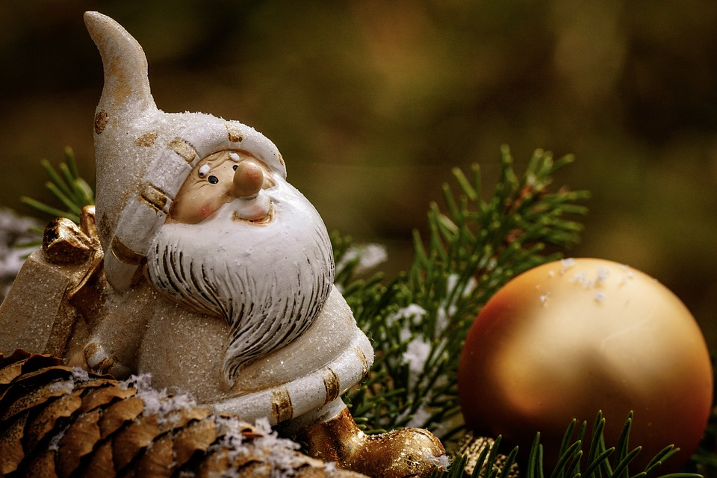
5
Talking Decorations
Santa Decoration: Merry Christmas Golden Ball. It’s nice to be out of the box and hanging on the tree again. How are you?
Golden Ball: Hello, Santa. I am so excited that it is Christmas! I’m glad we are at the top of the tree. Last year I was at the bottom and the cat kept hitting me.
Santa: What a naughty cat! Yes, I like the top of the tree as well. I can see much more of the house and family.
Golden Ball: That is true. I love watching the children open their presents in the morning! What a merry Christmas!

Slide 8
6
A Story for Eddie
Father: Eddie, it is Christmas Eve and I want to read you a special holiday story. It’s called “A Holy Night in Bethlehem”.
Eddie: Does it have robots in it? I love robots. Or maybe dinosaurs? They are so cool. Or how about spaceships?
Father: No, no- it’s a Christmas story. It’s all about angels, a bright star, wise men and the very first Christmas long ago. That is what Christmas is really about. The day that Jesus was born.
Eddie: Well the pictures sure look interesting. I’m looking forward to hearing this Christmas story. Thanks a lot, dad.

Slide 9
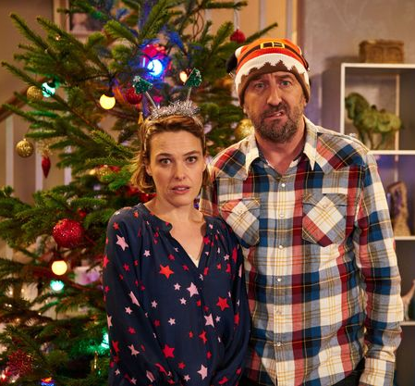
7
No Christmas Dinner
Wife: Well darling, we have finished wrapping the presents and putting up the Christmas tree. Should we start dinner?
Husband: Sounds great! Now where did I put the groceries? Oh, no! I think I left them in the shopping cart at the supermarket. How forgetful of me!
Wife: What can we do? The shops will be closed now and I’m hungry. What can we have for Christmas dinner? All we have in the fridge is cold noodles and tuna.
Husband: Yuck! That sounds terrible. I know, let’s order pizza and chicken wings. We can have a take-out Christmas dinner!

Slide 10
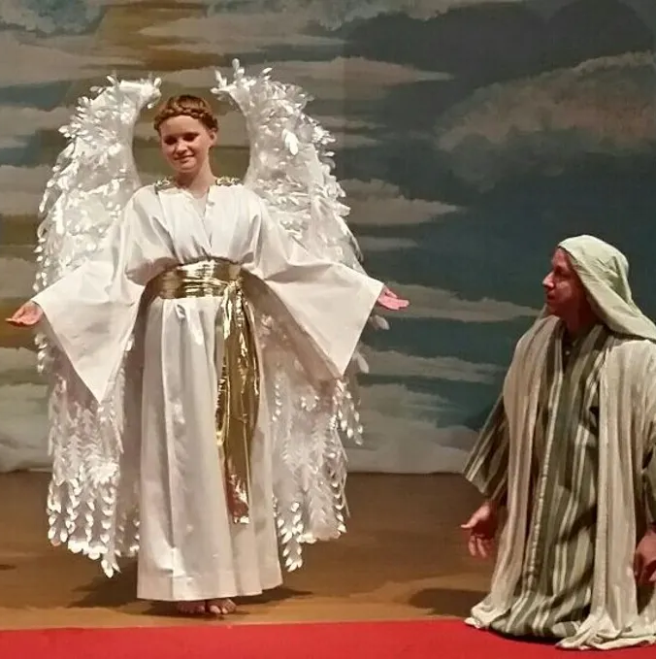
8
The First Christmas
Angel: Greetings shepherd. Tonight is a special night. Christ the King is born!
Shepherd: King? I didn’t know we had a king. I thought we elected our leaders.
Angel: This is a baby King, who is the Son of God. He was born tonight in a manger. Just follow the bright star.
Shepherd: That sounds amazing. I want to see this. Thanks for letting me know. Wait, I don’t a present for the baby King.
Angel: That’s ok. This special day is not about presents, it’s about Christ and love.

Slide 11
11
A Grumpy Panda
Panda: Hey who is that strange man in the funny red and white clothes? What is he doing in my home? Should I call for help?
Santa: Don’t worry, Panda. I’m Santa and I brought you a Christmas tree for the holidays. Have a merry Christmas!
Panda: Don’t you know I only like bamboo trees! I can’t eat that tree. What are all those colourful things on the tree?
Santa: They are decorations. No Christmas tree is complete without decorations.
Panda: Well, I guess the tree does look pretty. Ok, you can stay Santa. Merry Christmas to you. Have some bamboo.

Slide 12
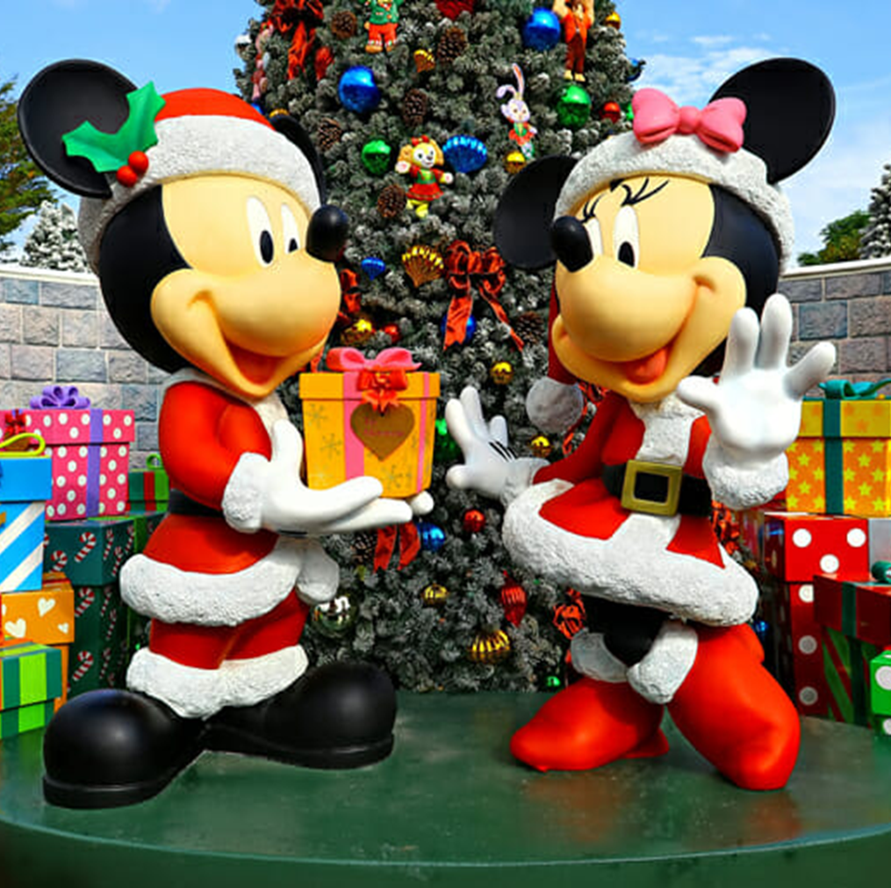
10
A Merry Disney Christmas
Minnie: Well we did it. We finished wrapping all these presents for the boys and girls who visit us. I’m tired now.
Mickey: Yes, me too. I hope they like the toys. Minnie- I have this gift for you, it’s something I made myself.
Minnie: How very thoughtful. Thank you Mickey. Let’s put it under our tree and I’ll open it Christmas Day. I’m so excited.
Mickey: Good idea. Hey there’s already something under the tree. It looks lovely.
Minnie: That’s just a little something for you. Something I think you’ll like.

Slide 13
9
Putting up Lights
Todd: What a cold and snowy night. We should have put up the lights during the day when it was warmer.
Rachel: That’s ok, we’re wearing enough clothes. It’s important to see what the lights look like at night.
Todd: I’ll put up these round white lights while you place the Christmas star. Where should I put these?
Rachel: How about on the wall? They will look great there. I’m going to put the star on our front door.
Todd: Good idea. I think our house will look great with all these holiday lights.

Slide 14
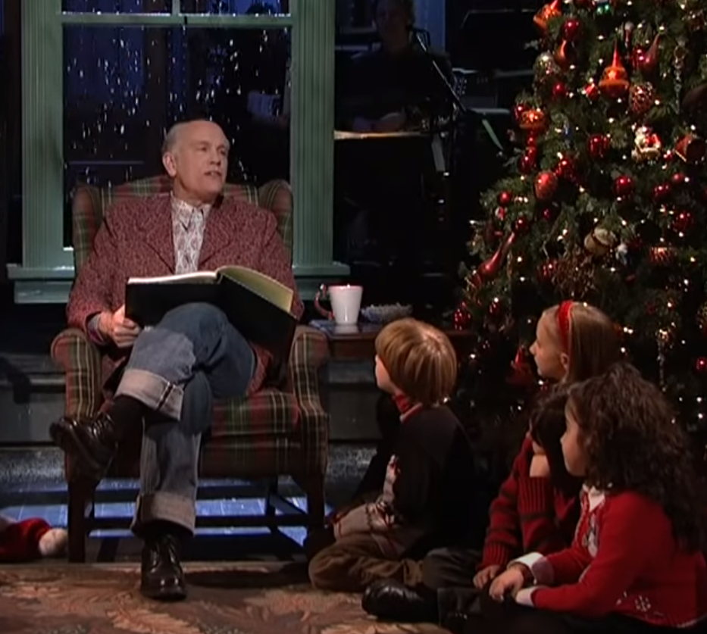
12
Grandfather’s Stories
Grandpa: Tonight I will read you the holiday story of Frosty the Snowman. It’s quite famous.
Children: Great! What is the story about?
Grandpa: Well, it’s about a snowman who wears a magic hat and comes to life and then dances around town! He has coal eyes and a carrot nose.
Children: A magic hat? A living snowman? Wouldn’t he melt during summer or if he went inside? It sounds like a very strange story.
Grandpa: Ok, how about the story of Rudolph? He’s a magical flying reindeer with a glowing nose who leads a flying gift sleigh in the fog.
Children: Where do you get these crazy stories?

Slide 15
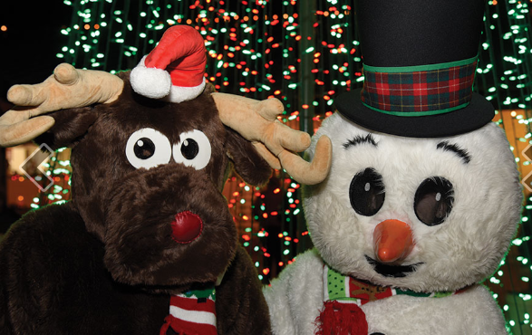
Bonus Mini-Drama
Working on Christmas
Reindeer: I can’t believe we have to work on Christmas Day! We should be home with our families.
Snowman: But the children love talking to us and we help make the park more festive and merry. Everyone likes the park reindeer and snowman!
Reindeer: True, but these costumes are so heavy and hot. I can hardly see and I keep bumping into people.
Snowman: You’ll get used to it. It isn’t so bad. And with the extra money we make we can go shopping on Boxing day and buy some great deals!

Slide 16
A very merry Christmas to everyone in the OLR family.
Wishing you a happy and healthy holiday and all the best in 2023!

